Slide 1
Setup instructions
Connect Raspberry Pi and access point to power – requires a 2A power adapter minimum!!!!
Connect Laptop to acces point ‘devices’, password as printed on device
Open browser, http://tplinkwifi.net or 192.168.0.1
Log-in with username and password as printed on device
Navigate to ‘Wireless’
In Client Settings configure customer network SSID and Password
Navigate to ‘DHCP’ -> ‘DHCP Client List’ to find IP addresses of connected devices, look for Raspberry2 device

Slide 2
Demo instructions
Connect to Pi using SSH ‘pi@192.168.0.10x’, standard password
Change directory ‘cd /greengrass/ggc/core/
Run ‘sudo ./greengrassd start‘
Run ‘ps aux | grep -E 'greengrass.*daemon‘‘ to ensure process is running
Open IoT test console https://eu-central-1.console.aws.amazon.com/iot/home?region=eu-central-1#/test
Subscribe to topic hello/world
Walk customer through set-up

Slide 3
MXNet on Edge
with Amazon Greengrass
Christian Petters, Solutions Architect
Saturday, July 28, 2018
Notes:
This is a subset of this deck: https://collaborate-corp.amazon.com/nuxeo/nxdoc/default/be02f110-9ed8-4dcd-92e2-edc506ee14d0/view_documents?conversationId=0NXMAIN2

Slide 4
AWS Greengrass
Extend intelligence to the edge
Local actions
Local
triggers
Over the air updates
Data and state sync
Protocol adapter for OPC-UA
Security
Local resource access
Local ML inference
Preview today

Slide 5

Greengrass ML Inference
AWS Greengrass ML Inference
Build and train ML models in the cloud
Use Greengrass to deploy optimized models on your target device
Accelerate ML inference applications on the edge
Devices take action quickly – even when disconnected

Slide 6
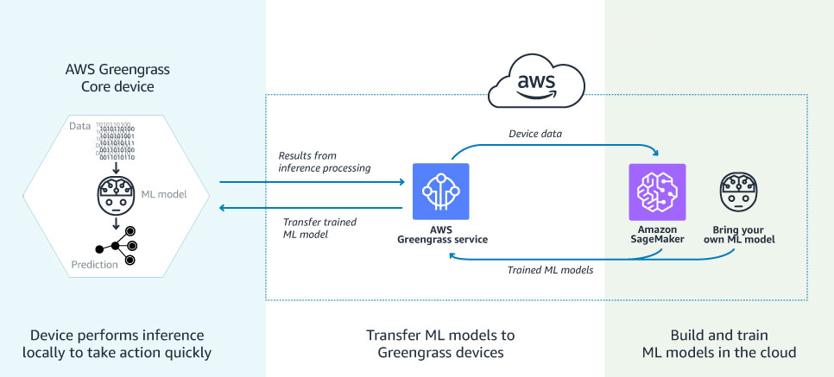
Greengrass ML Inference
AWS Greengrass ML Inference

Slide 7


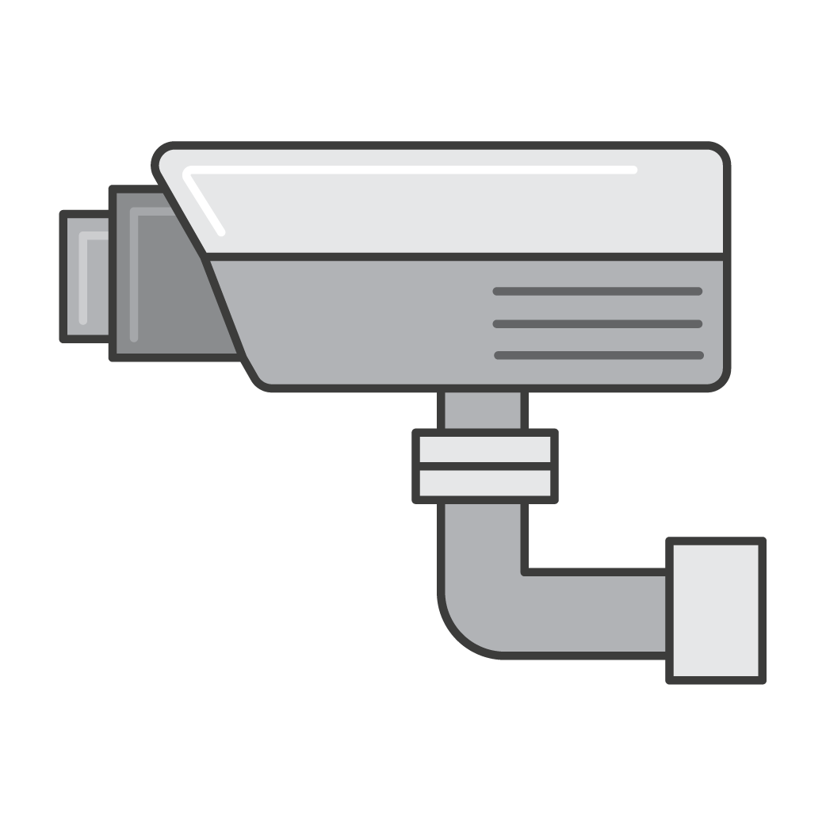



Use Cases
Connected cars
Smart Agriculture
Predictive maintenance
Video surveillance
Robotics
!
Image recognition
Voice/sound recognition
Collision avoidance
Anomaly detection
More

Slide 8
Benefits of ML Inference at the Edge
Latency
Bandwidth
Availability
Privacy

Slide 9
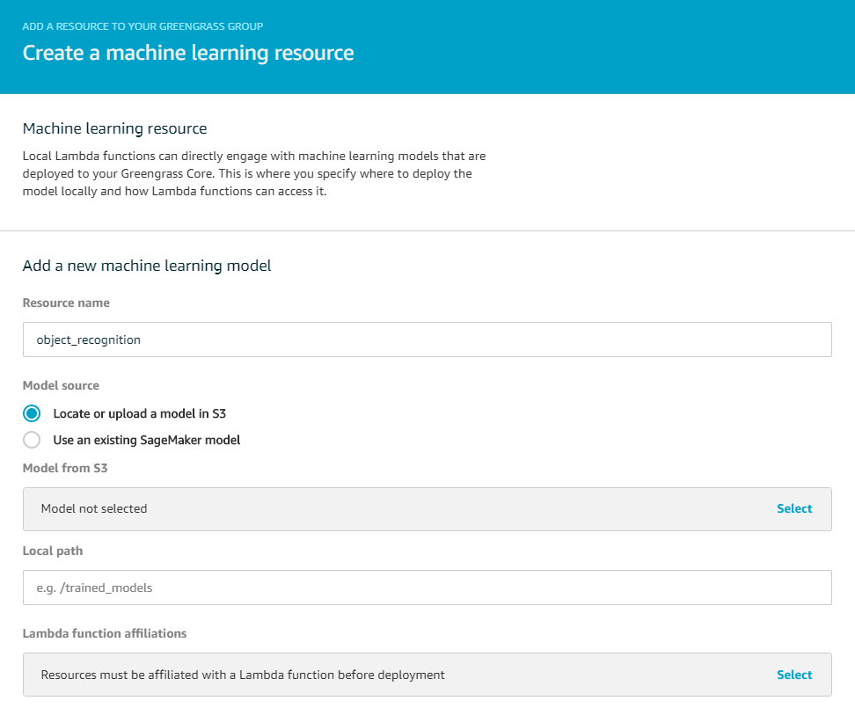
Deploy cloud trained models
Deploy cloud trained models to target devices for you
Locate Amazon SageMaker trained models in Greengrass console
Or bring your own models
Add your trained model as a “Machine Learning” resource to Greengrass group
Deploy to Greengrass devices

Slide 10
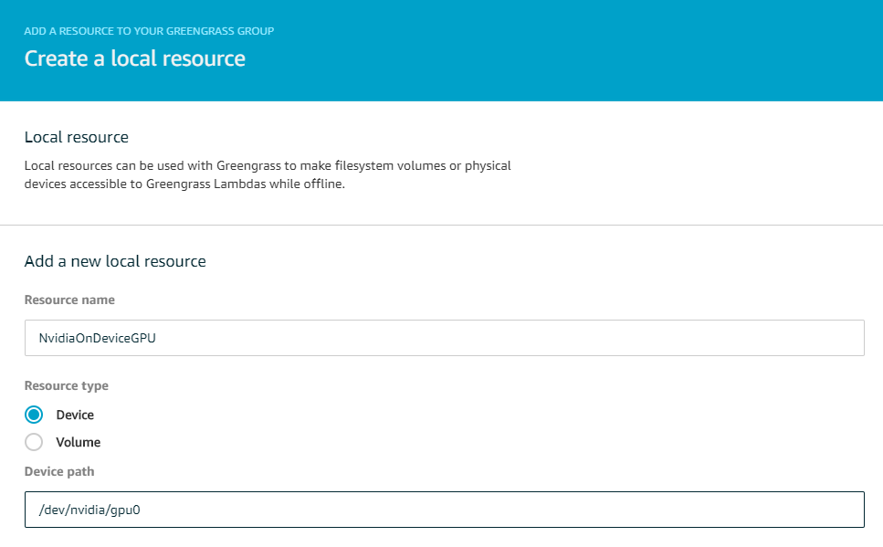
Access hardware accelerators
Access on-device ML accelerators such as GPU and FPGA from Lambda functions to speed up inference
No code required
Simply declare the accelerator as a “Local Resource” that Lambda functions need to access

Slide 11
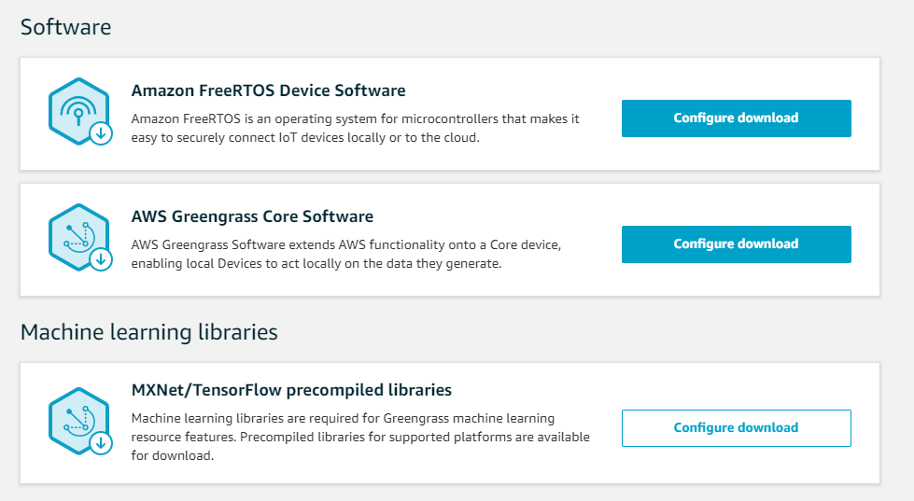
Pre-built MXNet and TensorFlow for devices
Pre-built MXNet and TensorFlow packages so you don’t need build them from scratch for your devices
Intel Atom
NVIDIA Jetson TX2
Raspberry Pi
You can always bring your own frameworks
Notes:
Version 0.11 of MXNet out of the box

Slide 12
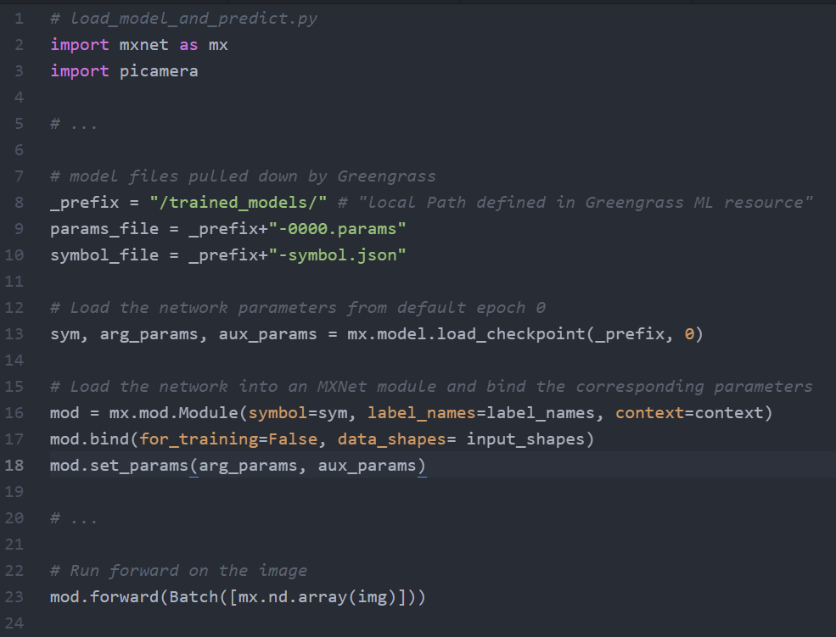
Lambda inference examples
Lambda examples to help you create inference apps, showing you how to
Load trained models
Apply them to locally generated data for local inference
Take actions

Slide 13
Demo time
Notes:
Connect to Pi using SSH ‘pi@192.168.0.10x’, standard password
Change directory ‘cd /greengrass/ggc/core/
Run ‘sudo ./greengrassd start‘
Run ‘ps aux | grep -E 'greengrass.*daemon‘‘ to ensure process is running
Open IoT test console https://eu-central-1.console.aws.amazon.com/iot/home?region=eu-central-1#/test
Subscribe to topic hello/world
Walk customer through set-up

Slide 14
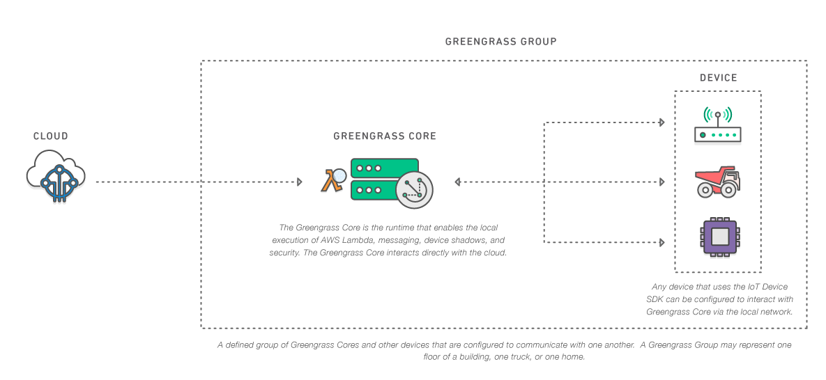
Review

Slide 15
Reference
https://docs.aws.amazon.com/greengrass/latest/developerguide/ml-inference.html

